Slide 1
CS 234 Session III
RL with Function Approximation

Slide 2
Content
Lecture Review
Motivation & SGD review
Neural Network Basics
Definition
Backpropagation
Fully-connected networks
Convolutional neural networks

Slide 3
Lecture Review

Slide 4
Review: Why use Function Approximation?
PROS
Efficient state value representation
Generalization to unseen states
CONS
Not exact (i.e. can have error even for states visited many times)
Convergence guarantees are lost
Notes:
PROS example: state space is all 256x256 color images, state space is continuous → Necessary for any complex environments that resemble real world!
CONS example: extreme case is when function is constant

Slide 5




Review: Stochastic Gradient Descent
Loss function:
Parametrized by and differentiable w.r.t its parameters
Training data:
Set of training examples
Objective? Iteratively find parameters that minimize the loss! How? By following the (negative) gradient

Slide 6


Review: Stochastic Gradient Descent
Gradient of loss
During each iteration, update the parameter vector
Learning rate controls the rate of update
Notes:
How do we compute the gradient? Recall that the gradient of a function of several variables takes the following form
During each iteration, update the parameter vector in the direction of the negative gradient

Slide 7
Neural Network Basics

Slide 8
What is a Neural Network?
A neural network is a function that consists of:
Neurons that take values and produce an output
Weights that control how values are carried between neurons
Neurons are grouped into layers:
Input layer
Hidden layer(s)
Output layer

Slide 9












A Deeper Look at a Neuron
A neuron can have many inputs, but produces one value
When you have many neurons, it becomes a (fully-connected) layer

Slide 10

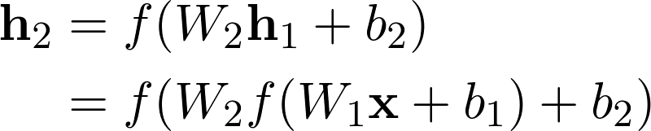


More Details
No matter how many layers are stacked, it’s still a linear function!
We apply non-linear function to the output of each layer
Starting from the input
Output of hidden layer 1:
Output of hidden layer 2:
Output of hidden layer 3:
where is an element-wise activation function
In Tensorflow: tf.layers.dense

Slide 11

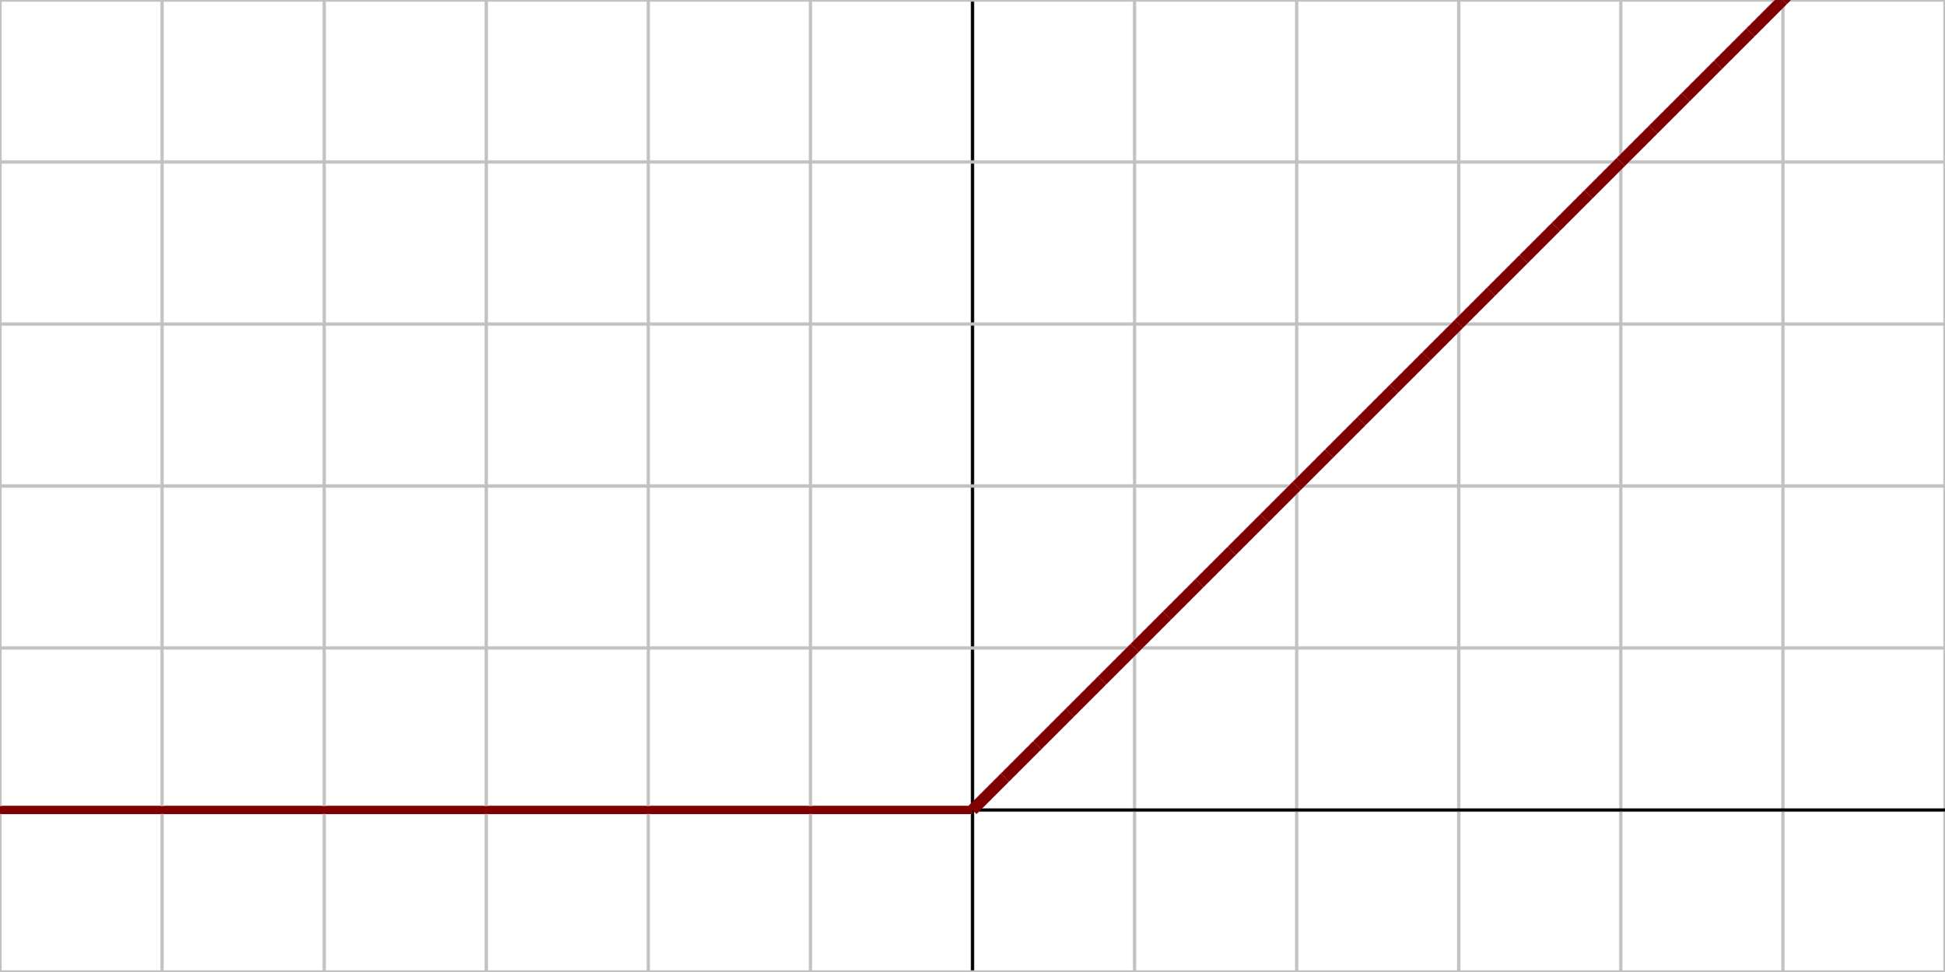
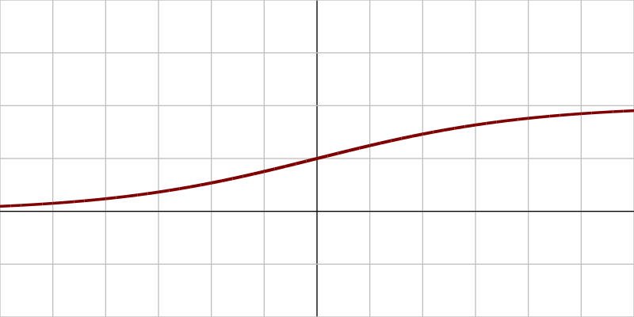
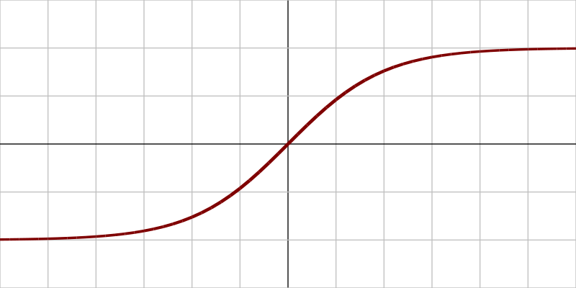

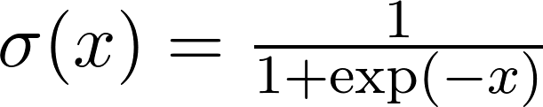
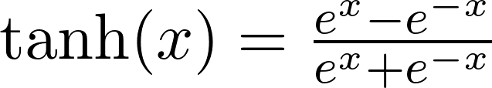
Activation Functions
Generally a monotonic, differentiable, non-linear function from
Applied to each element of a vector, matrix, tensor.
Lots of options to choose from:
ReLU, sigmoid, tanh, leaky ReLU, SoftPlus, ELU, SELU …
Examples: tf.nn.relu tf.nn.sigmoid tf.nn.tanh
Notes:
Discuss the properties of each example
ReLU: bounded below by zero, not upperbounded, strictly increasing in [0, inf)
Sigmoid: range is (0, 1), strictly increasing
Tanh: range is (-1, 1)
These properties affect which one to use

Slide 12




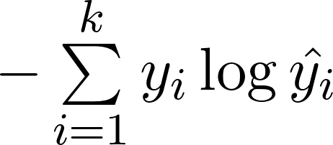
Loss Functions
Measures the quality of network predictions → problem dependent
For prediction and the expected (true) value
For regression:
L1 loss:
L2 loss:
For classification:
Cross-entropy loss:
Binary case:

Slide 13








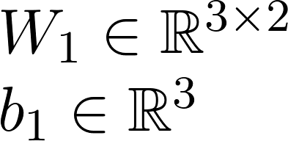
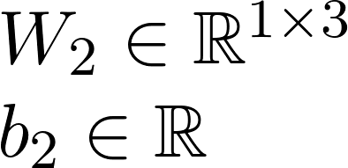
Backpropagation Example
Taking the gradient of a neural network is done layer-by-layer
Example: 1-hidden layer neural network for binary cross-entropy loss
Notes:
Explain why the derivative of sigmoid(z) is z(1-z)

Slide 14
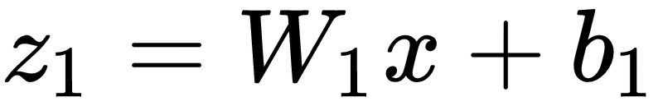

Backpropagation Example
Notation
Layer 1 (pre-activation):
Layer 1 (post-activation):
Layer 2 (pre-activation):
Network output:
Binary cross-entropy loss:

Slide 15
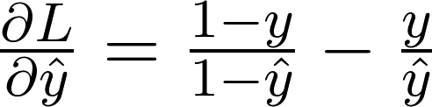
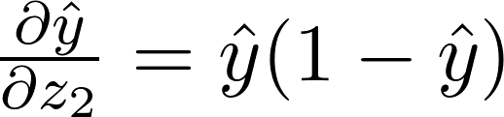
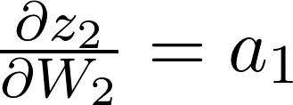
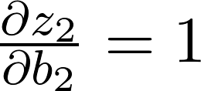
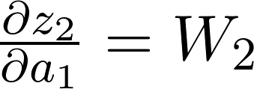
Backpropagation Example (cont’d)
Step 1: loss → layer 2 output:
Step 2: layer 2 output → :
Step 3: → layer 2 weights:
Step 4: → layer 1 output:
Notes:
Explain why the derivative of sigmoid(z) is z(1-z)

Slide 16
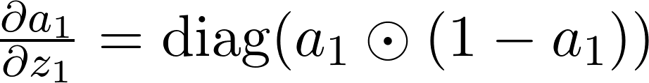

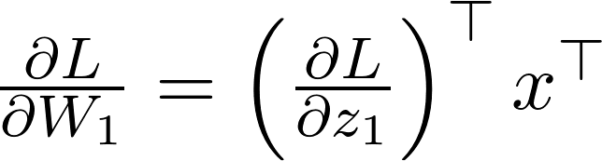
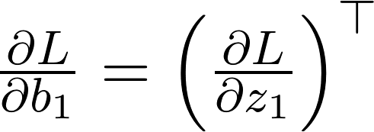
Backpropagation Example (cont’d)
Step 5: layer 1 output → :
Step 6: loss → layer 1 weights:
Now we apply chain rule!
Notes:
Explain step 6 in detail -- why we avoid computing (d z_1) / (d W_1)

Slide 17
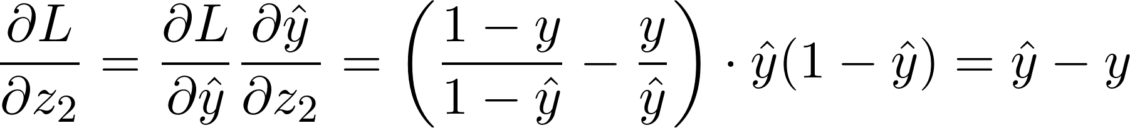
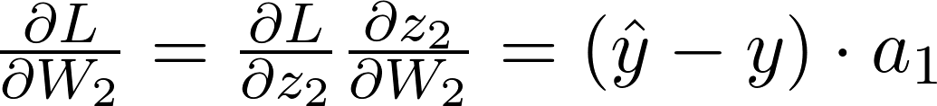
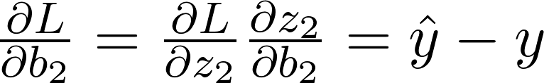
Backpropagation Example (cont’d)
Layer 2 gradients:
Notes:
Mention that these gradients can be computed quickly because the intermediate outputs and layer-to-layer gradients are cached

Slide 18
Backpropagation Example (cont’d)
Layer 1 gradients:
Do the shapes match?
Notes:
Mention that these gradients can be computed quickly because the intermediate outputs and layer-to-layer gradients are cached

Slide 19
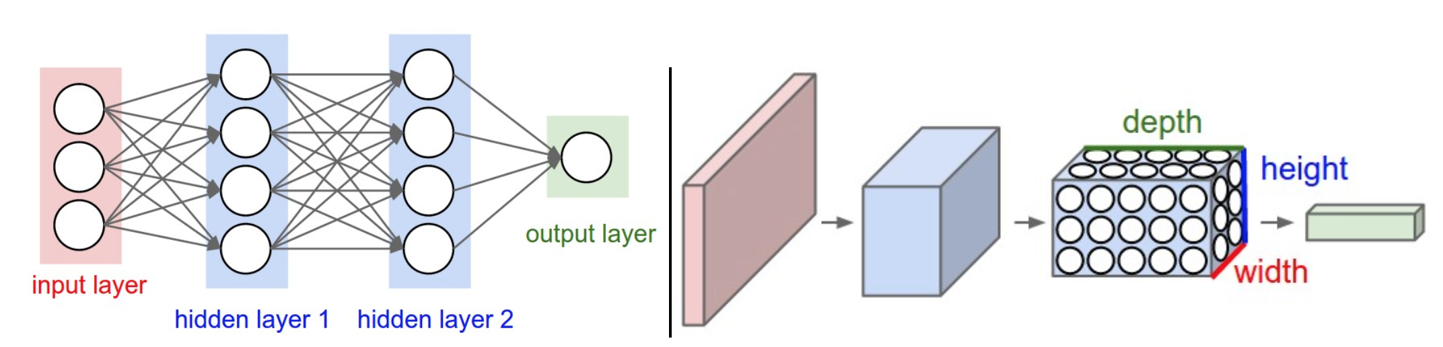
Convolutional Neural Network (CNN)
A type of layer called convolutional layer plays well with 2D input.
It computes the output (which is also 2D) by sliding over its filter (kernel) over the input, taking the sum of element-wise products.
Much fewer parameters than fully-connected layers.
A simple CNN might look like this: x → conv → conv → conv → FC
(diagram from CS231N notes)
Notes:
Clarify that by “2D” we really mean a 3D tensor, and the depth of the filter is same as input depth.

Slide 20
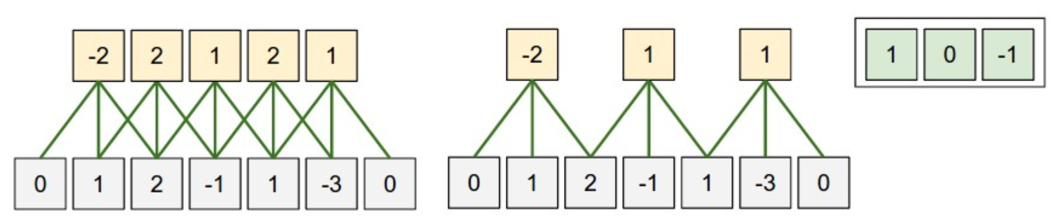
Conv layer in 1D
Let’s take a look at a simpler case of 1D input
Filter (kernel) size controls how wide the filter is
Stride controls how much move the filter by after each step
stride = 1, filter_size = 3
stride = 2, filter_size = 3
(diagram from CS231N notes)

Slide 21
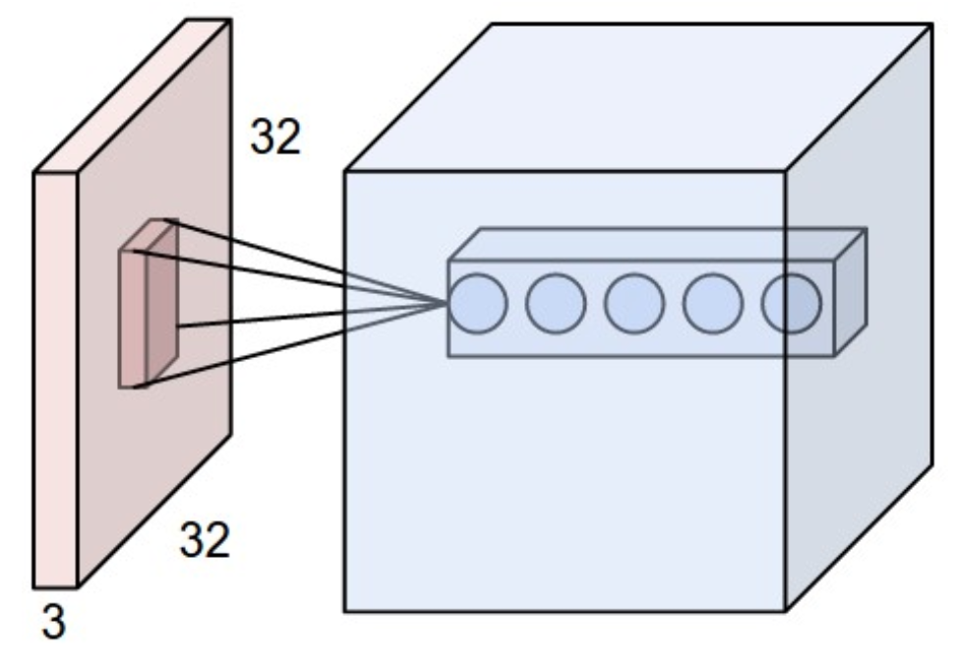
Volumes and Depths
Same idea, except everything is 2-dimensional now.
For color images, each pixel has three color channels, so the input is actually a 3D tensor of shape (H, W, 3)!
Thus, conv layers take 3D input volumes and produces output 3D volumes.
Size of the last axis (color channel) is the depth of a volume.
Filter is also 3D, with the same depth as the input volume.
(diagram from CS231N notes)

Slide 22
Padding
For any filter size > 1, the output size is smaller
We can pad the width and height (but not depth) of the input volume!
Usually zero-padded
Allows us to control the output size of a conv layer.
(animation by Vincent Dumoulin)

Slide 23
Finally… Conv layer in 2D
Combining all of these, a conv layer has the following parameters:
Stride: controls how much the filter moves by
Padding: controls how much the input volume is extended by around its edges
Filter size: controls the width and height of the filter (remember: depth is always equal to the input depth)
The 2D slice through a specific depth is called a feature map.
3D volume = stack of feature maps
In Tensorflow: tf.layers.conv2d

Slide 24

Conv Layer Animation
(video from CS230 lecture notes)

Slide 25
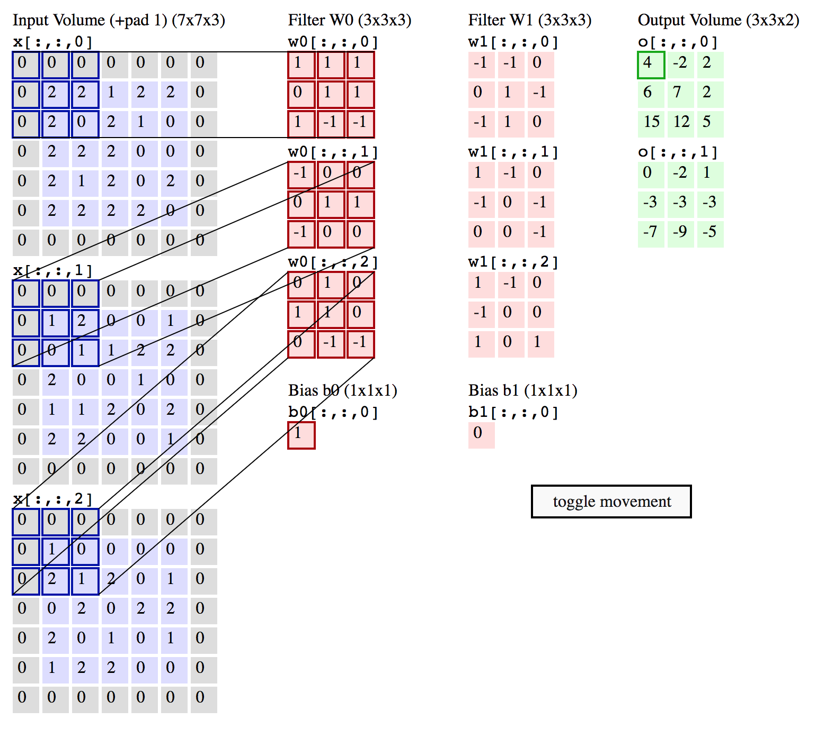
Conv Layer Example
Input shape: (5, 5, 3)
Height = 5
Width = 5
Depth = 3
Padding: 1
Conv layer
Filter size = (3, 3)
Filter depth = 3
Output channels = 2
Stride = 2
Output shape: (3, 3, 2)
(diagram from CS231N notes)

Slide 26
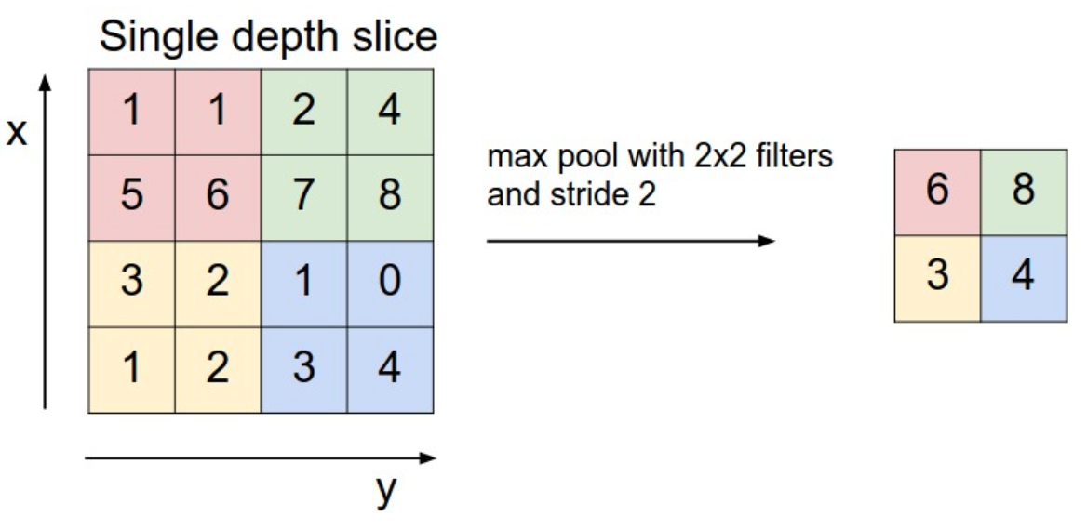
Pooling Layer
Another way to shrink the dimensions of output volume.
Usually applied immediately following a conv layer.
Pooling layers simplify / compress the information in the output from a conv layer by downsampling the input volume.
Max pooling: takes the maximum of the numbers in the receptive field.
No parameter to be trained!
(diagram from CS231N notes)

Slide 27
Parameter Efficiency
The same filter is shared across the entire input volume.
All the neurons in an output feature map detect the same feature, just at different locations in the input image.
Takes advantage of the translational invariance of image features.
Example layer sizes: (32 x 32 x 3) → (16 x 16 x 10) → 10
Fully-connected network: 3072 * 2560 + 2560 * 10 = ~7.9M
CNN with 5x5 kernel & 2x2 pooling: 5 * 5 * 3 * 10 + 2560 * 10 = ~26K
About 300x fewer parameters than fully-connected network!

Slide 28
TF References & Further Reading
READ THE DOCUMENTATION!
KEYWORD ARGUMENTS ARE IMPORTANT
Backpropagation: CS224N notes
Fully-connected (“dense”) layer: tf.layers.dense
Convolutional layer (2D): tf.layers.conv2d
Activation functions: ReLU(tf.nn.relu), Sigmoid (tf.nn.sigmoid)
Other useful techniques:
Batch Normalization: (tf.layers.batch_normalization)
Regularization: CS231N notes
L1 / L2 regularization, Dropout

Slide 29
Questions?

Slide 32
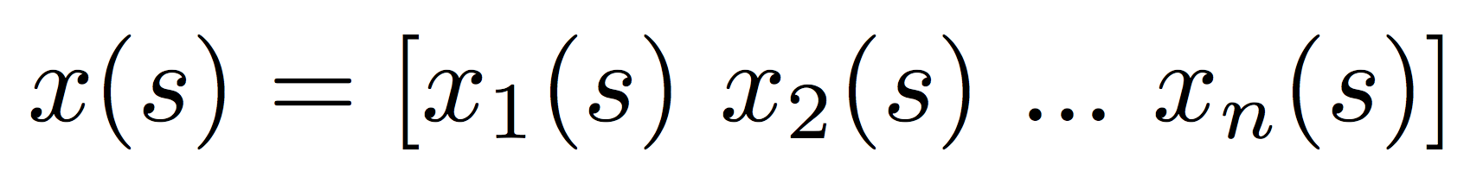
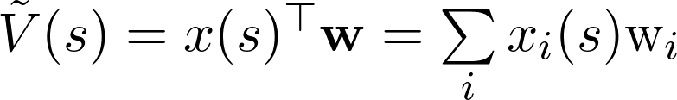
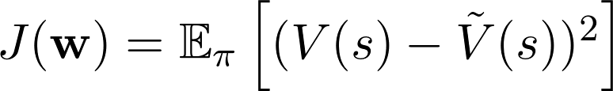
Review: Assumptions for VFA
Assumptions
Feature function:
Linearity:
L2 loss:
In practice, these assumptions are often not true

Slide 33
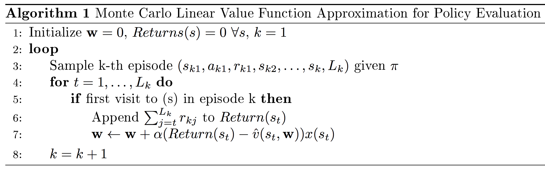
Review: Monte Carlo Policy Evaluation with VFA
What would the update rule for TD(0) policy evaluation look like?
Notes:
Explain the update:
Where does (Return(s_t) - V(s_t, w)) come from?
How \nabla J(w) turns into x(s_t) because of linearity
Question: What would happen for TD policy eval?

Slide 34
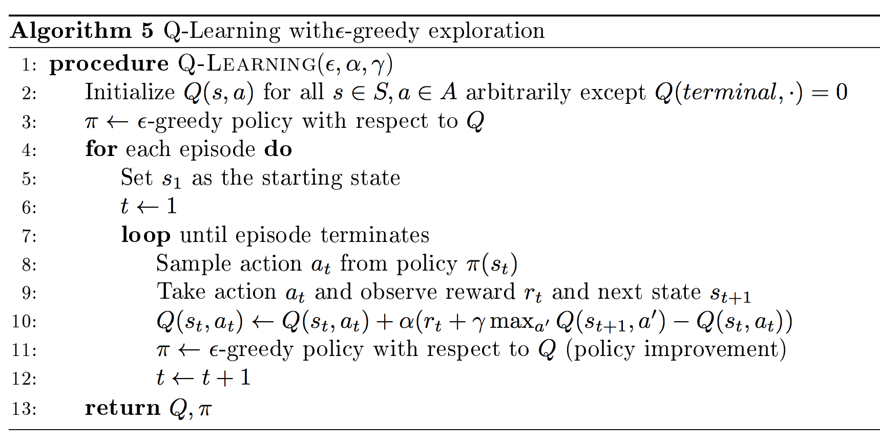
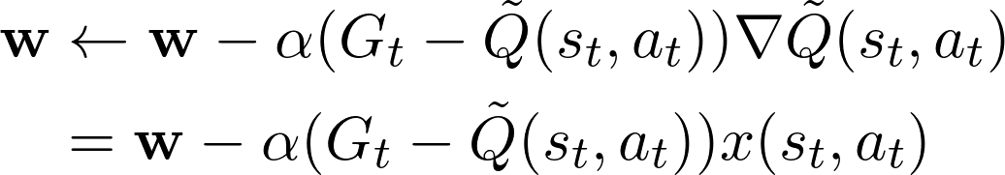
Review: Control with VFA
As explained last week, we need Q(s,a) for model-free control
Analogously, update rule changes to:

Slide 35
Back to Value Function Approximation
How do we represent the value function Q(s,a) with a neural net?
Same as linear function approximation (with SGD)
Tensorflow computes the gradient for us!
What should be the dimension of the output?
CNN works well for Atari (states are images)

